Slide 1

Department of Computer Science and Engineering
CLOUD COMPUTING
Installation of Hadoop Single Node Cluster & WordCount
Supervisor
Mrs. ThivaPriya
CLOUD COMPUTING LAB — EXPERIMENT 07

Slide 2
CONTENTS
Experiment Aim
Hadoop & Its Modules
Install Java, SSH & Hadoop
Configure Hadoop Environment
Configure HDFS, YARN & MapReduce
Start Hadoop Services
MapReduce & WordCount
Run WordCount & Verify Output
Result & Key Takeaways

Slide 3
EXPERIMENT AIM
Ex. No: 07 — Hadoop Single Node Cluster
AIM:
To find the procedure to set up a one-node Hadoop cluster and run a simple WordCount application.
WHAT WE WILL ACHIEVE
• Install Java as the main prerequisite for Hadoop.
• Configure SSH and create the Hadoop user.
• Install and configure Hadoop.
• Configure HDFS, YARN and MapReduce.
• Start the Hadoop services and verify the cluster.
• Run the WordCount MapReduce application and verify the output.
3

Slide 4
HADOOP & ITS MODULES
FLOW
LAB ENVIRONMENT
JAVA
1. Java — main prerequisite for running Hadoop.
2. SSH — enables passwordless local communication during setup.
3. Hadoop — framework for distributed storage and processing.
4. HDFS — stores data across the Hadoop file system.
5. YARN — manages cluster resources and application scheduling.
6. MapReduce — programming model for large-scale data processing.
SSH
HADOOP
HDFS
YARN
MAPREDUCE

Slide 5

INSTALL HADOOP
STEP-BY-STEP PROCEDURE
1. Update the package list and install Java.
2. Install the OpenSSH server.
3. Generate an SSH key for passwordless local access.
4. Create the Hadoop group and user.
5. Copy the Hadoop archive to the system.
6. Extract Hadoop into /usr/local/lib/.
7. Change ownership of the Hadoop directory.
8. Create the HDFS NameNode and DataNode directories.
9. Verify the Java installation path.
10. Add Hadoop and Java environment variables to ~/.bashrc.
CHECKPOINT ✓ Google App Engine development
tools are configured.
5

Slide 6
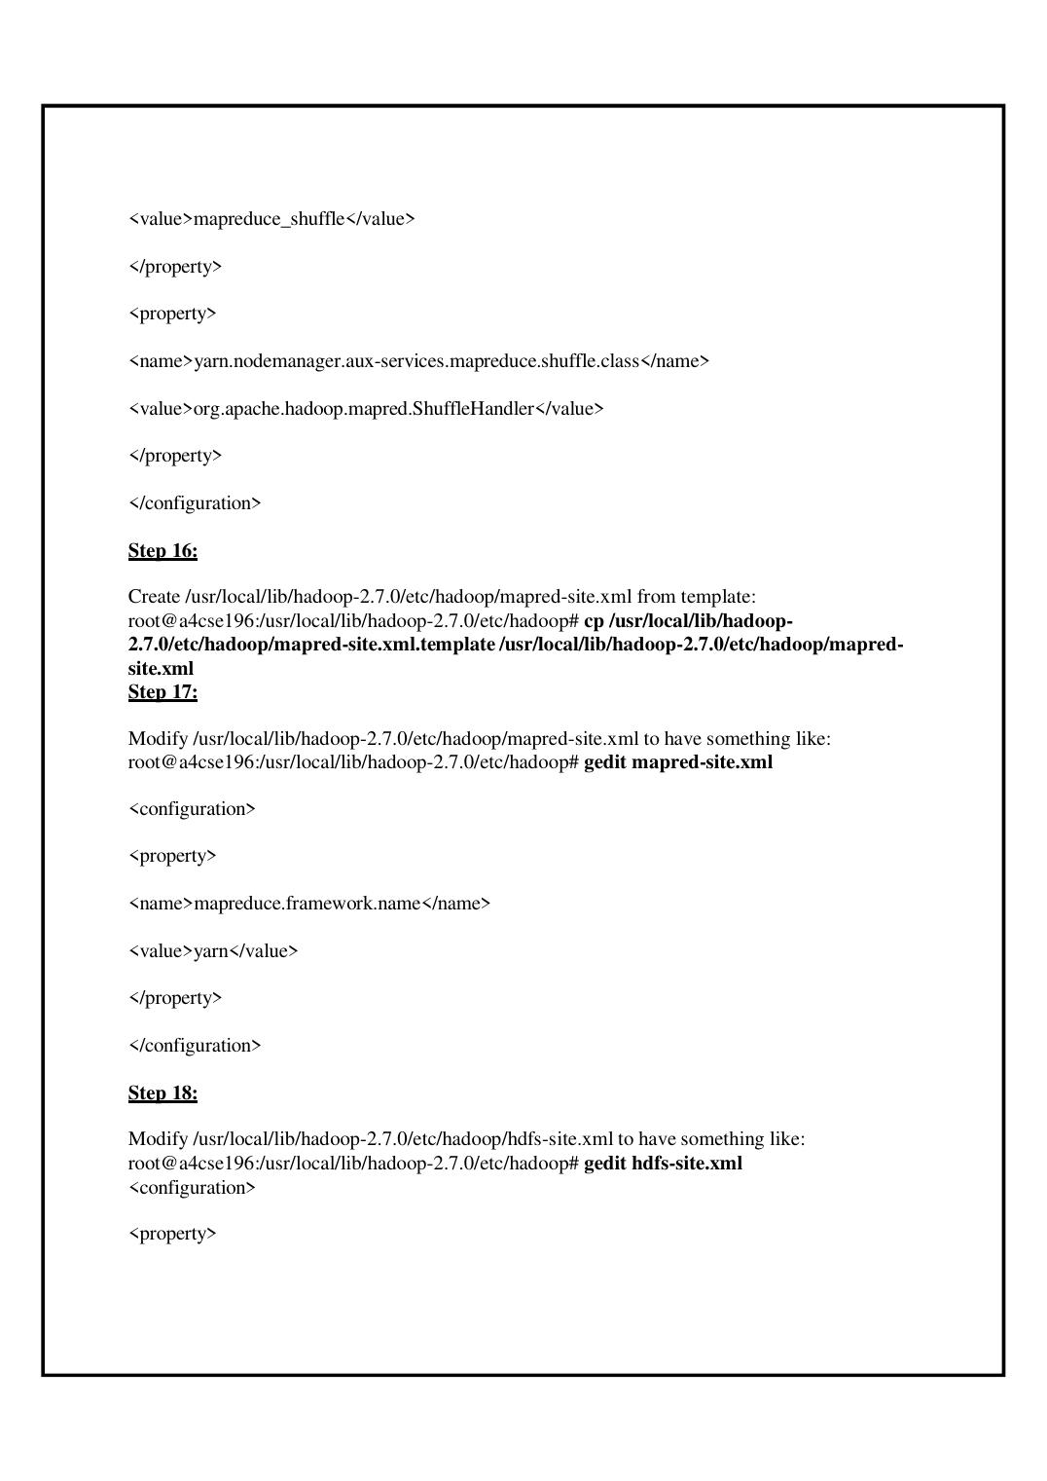
CONFIGURE HADOOP
HADOOP CONFIGURATION
1. Set JAVA_HOME and HADOOP_INSTALL environment variables.
2. Configure hadoop-env.sh with the Java installation path.
3. Configure core-site.xml with the HDFS NameNode address.
4. Configure yarn-site.xml for MapReduce shuffle services.
5. Configure mapred-site.xml to use YARN.
6. Configure hdfs-site.xml for replication, NameNode and DataNode directories.
7. Reload the environment using source ~/.bashrc.
PROJECT: HelloWorld
6

Slide 7
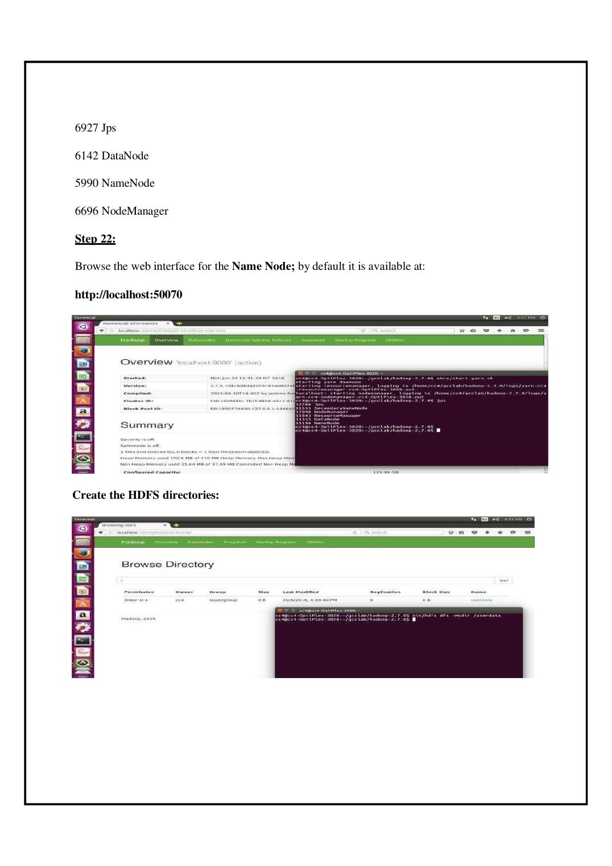
START & VERIFY HADOOP
START THE HADOOP CLUSTER
1. Format the NameNode using hdfs namenode –format.
2. Switch to the Hadoop user.
3. Start HDFS using start-dfs.sh.
4. Start YARN using start-yarn.sh.
5. Run jps to verify NameNode, DataNode, SecondaryNameNode, ResourceManager and NodeManager.
6. Open the NameNode web interface at http://localhost:50070.
VERIFY THE CLUSTER
7

Slide 8
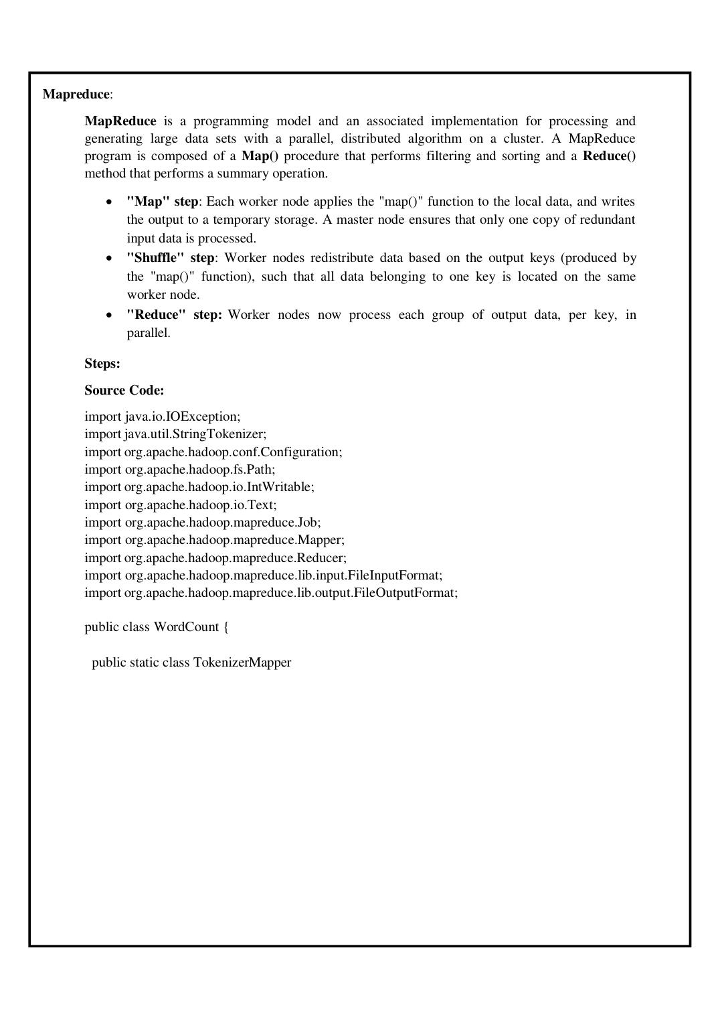
MAPREDUCE & WORDCOUNT
MAPREDUCE PROCESS
MapReduce processes large datasets using three main stages:
• Map — reads the input and produces key-value pairs such as (word, 1).
• Shuffle — groups values belonging to the same key.
• Reduce — combines the grouped values and produces the final count.
The WordCount program uses a Mapper to tokenize the input and a Reducer to sum the occurrences of each word.
WORDCOUNT APPLICATION
The Java WordCount program is compiled and packaged as a JAR file.
The application reads input from HDFS, performs MapReduce processing and writes the result back to an HDFS output directory.

Slide 9
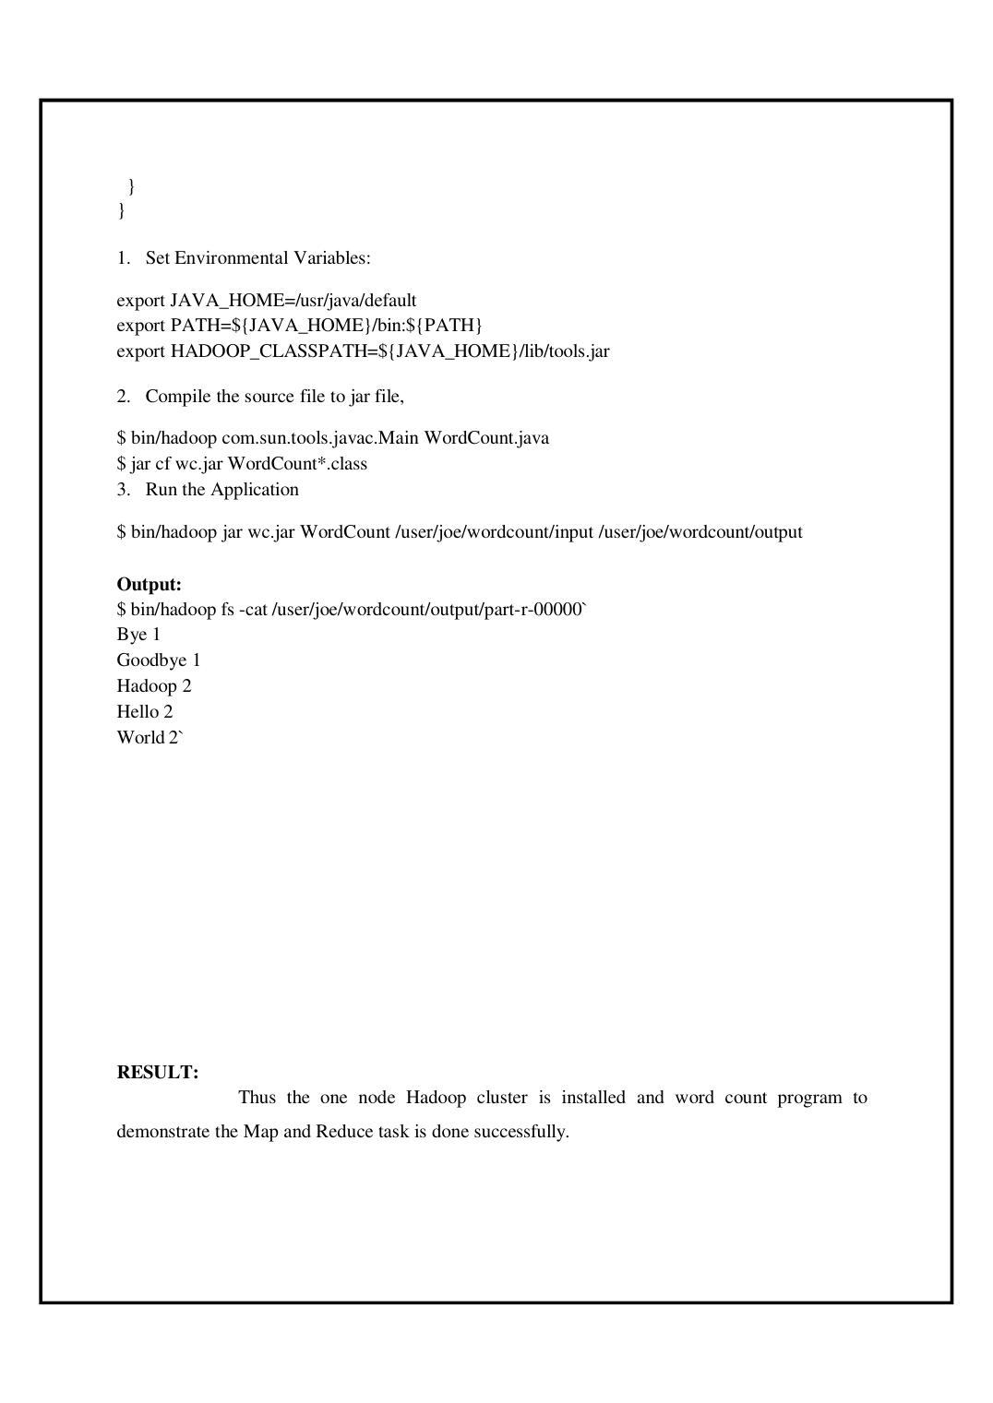
RUN WORDCOUNT & RESULT
RESULT
The one-node Hadoop cluster was successfully installed and configured. The WordCount application was compiled, executed and verified using HDFS and MapReduce.
KEY TAKEAWAYS
• Hadoop provides distributed storage and processing.
• HDFS stores data while YARN manages cluster resources.
• MapReduce performs parallel data processing using Map, Shuffle and Reduce.
• WordCount demonstrates the complete MapReduce workflow.
• The final word frequencies are stored in the HDFS output directory.
QUICK CHECK
What does the WordCount application demonstrate?
Answer: It demonstrates the Map and Reduce tasks by counting the occurrences of words in an input dataset.
9

